Slide 1
Testing
Instructor: Mehroze Khan

Slide 2
Software Faults and Failures Why Does Software Fail?
Wrong requirement: not what the customer wants
Missing requirement
Requirement impossible to implement
Faulty design
Faulty code
Improperly implemented design

Slide 3

Objective of Testing
Objective of testing: discover faults
A test is successful only when a fault is discovered
Fault identification is the process of determining what fault caused the failure
Fault correction is the process of making changes to the system so that the faults are removed

Slide 4
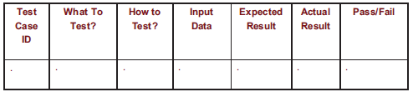
Elements of a Test Case
Purpose
Input
Expected Output
Actual Output
Sample Format:

Slide 5
Types of Faults
Algorithmic fault
When a component’s algorithm or logic does not produce the proper output for a given input because something is wrong with the processing steps
These faults are sometimes easy to spot just by reading through the program (called desk checking) or by submitting input data from each of the different classes of data that we expect the program to receive during its regular working
Typical algorithmic faults include:
branching too soon
branching too late
testing for the wrong condition
forgetting to initialize variables or set loop invariants
forgetting to test for a particular condition (e.g., when division by zero might occur)
comparing variables of inappropriate data types

Slide 6
Types of Faults
Syntax fault
Computation and precision fault
A formula’s implementation is wrong or does not compute result to required number of decimal places
Documentation fault
Documentation doesn’t match what program does
Capacity or boundary faults
System’s performance not acceptable when certain limits are reached
Timing or coordination faults
Occur when the code coordinating several processes executing simultaneously or in a carefully defined sequence is inadequate
Throughput or performance faults
System does not perform at the speed prescribed by requirements

Slide 7
Different Level of Failure Severity
Catastrophic: causes death or system loss
Critical: causes severe injury or major system damage
Marginal: causes minor injury or minor system damage
Minor: causes no injury or system damage

Slide 8
Testing Issues Attitude Toward Testing
Programs are viewed as components of a larger system, not as the property of those who wrote them

Slide 9
Testing Issues Who Performs the Test?
Independent test team
avoid conflict
personal responsibility vs need to discover faults
improve objectivity
allow testing and coding concurrently

Slide 10
Testing Issues Views of the Test Objects
If we view the test object from the outside as a closed box or black box whose contents are unknown, our testing feeds input to the closed box and notes what output is produced
Test’s goal is to be sure that every kind of input is submitted, and that the output observed matches the output expected
Open box (sometimes called clear box or white box); can use the structure of the test object to test in different ways
Devise test cases that execute all the statements or all the control paths within the component(s) to be sure the test object is working properly

Slide 11
Testing Issues Views of the Test Objects
Closed box or black box: functionality of the test objects
Equivalence Class, Boundary Value Analysis, Scenario-based, Decision Table based, State Machine based…
Clear box or white box: structure of the test objects
Control Flow
Basis Path, Branch, Statement, Decision…
Data Flow
Du Path, All-uses Path

Slide 12
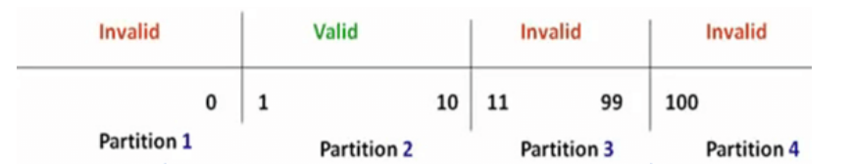
Black Box Testing Equivalence Class Partitioning
In this technique, input data units are divided into equivalent partitions that can be used to derive test cases which reduces time required for testing because of small number of test cases.
Notes:
Any Number greater than 10 entered in the Order Product Field(let say 11) is considered invalid.
Any Number less than 1 that is 0 or below, then it is considered invalid.
Numbers 1 to 10 are considered valid
Any 3 Digit Number say 100 is invalid.

Slide 13
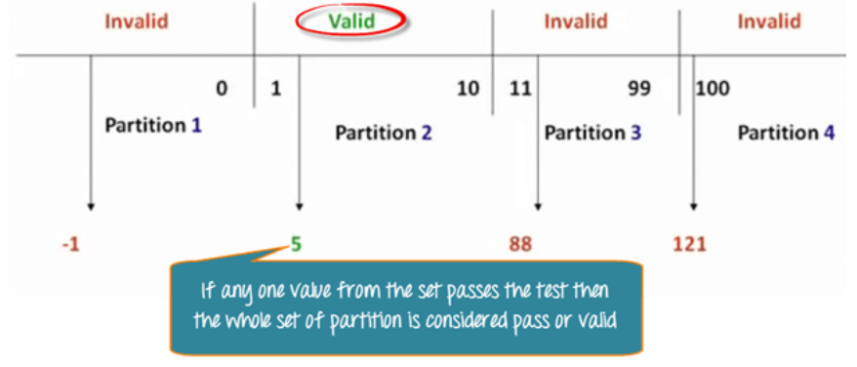
Black Box Testing Equivalence Class Partitioning

Slide 14
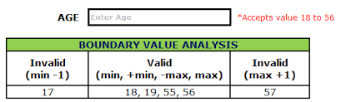
Black Box Testing Boundary Value Analysis
It is used to test boundary values because the input values near the boundary have higher chances of error.

Slide 15
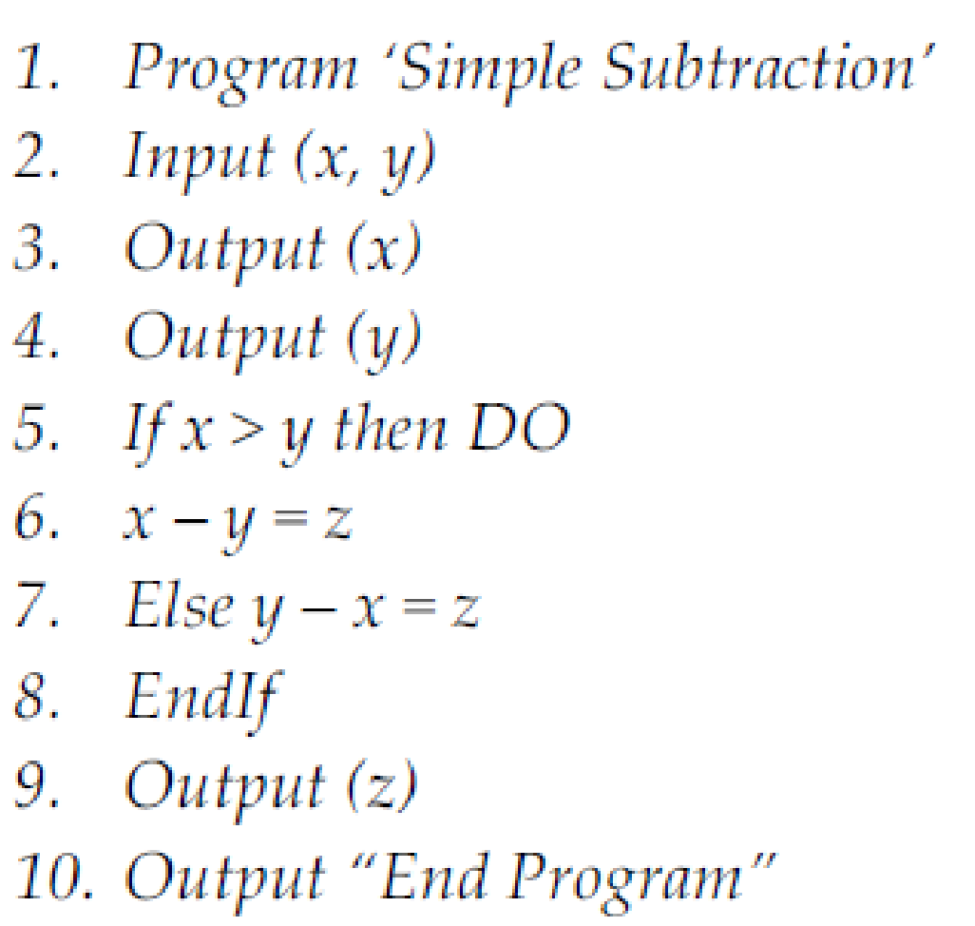
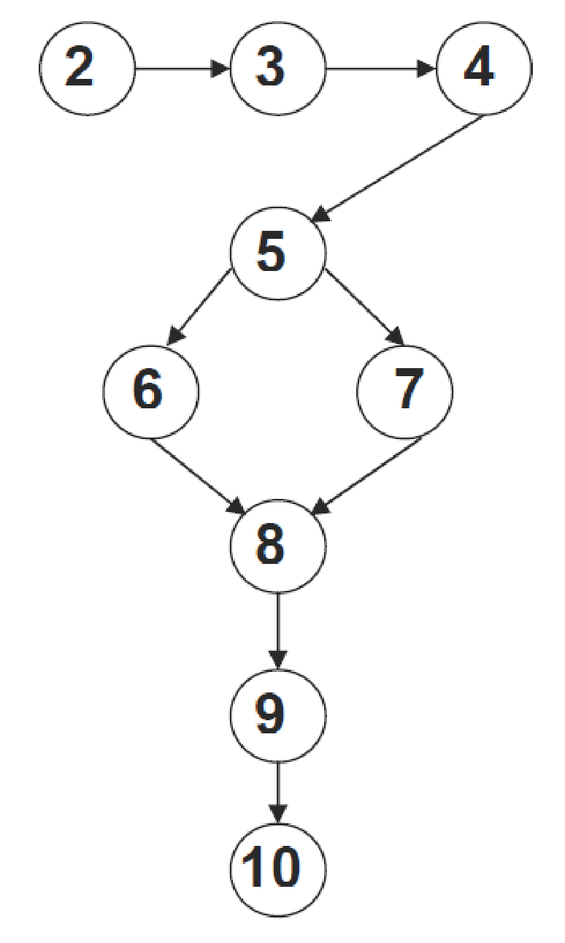
White Box Testing Control Flow Testing
Program
Control Flow Graph
Statement testing
Branch testing
Path testing
…
Notes:
The aim of this technique is to determine the execution paths through a module of program code and then creates and executes test cases to cover those paths.
It is mostly used in unit testing.

Slide 16
White Box Testing Control Flow Testing
Cyclomatic Complexity is the quantitative measure of the number of linearly independent paths in it.
It is a software metric used to describe the complexity of a program.
Complexity is computed as:
Cyclomatic complexity V(G) for a flow graph G is defined as
V(G) = E − N + 2
where E is the number of flow graph edges and N is the number of flow graph nodes.

Slide 17
White Box Testing Control Flow Testing
Cyclomatic Complexity:
V(G) = 9 edges − 9 nodes + 2 = 2.

Slide 18
White Box Testing Control Flow Testing
There are two independent paths:
Path 1: 2-3-4-5-6-8-9-10
Path 2: 2-3-4-5-7-8-9-10

Slide 19
Levels of Testing
Module testing, component testing, or unit testing
Integration testing
System Testing
Function testing
Performance testing
Acceptance testing
Installation testing

Slide 20
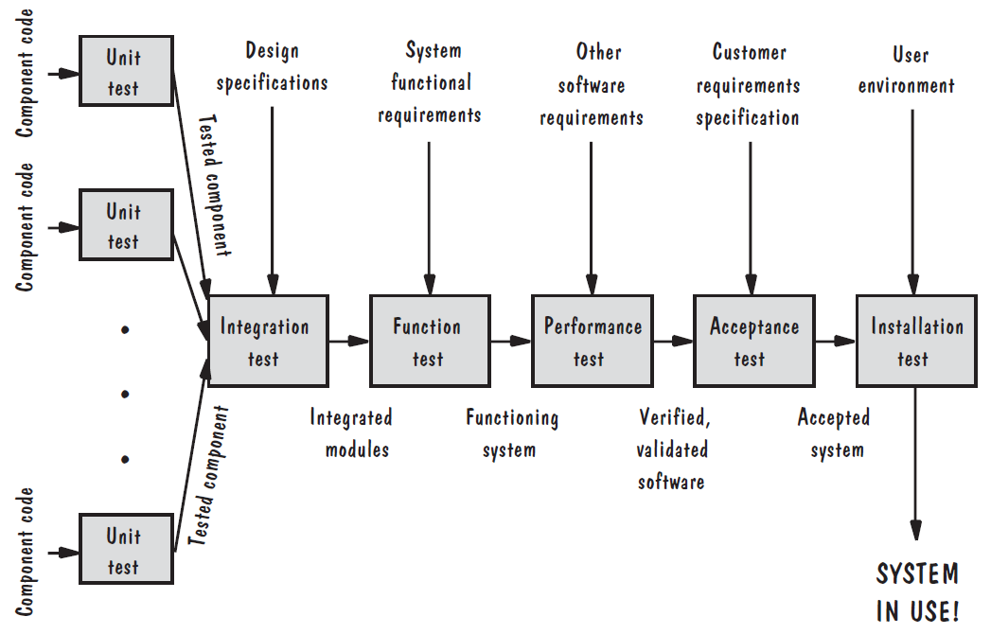
Levels of Testing Testing Organization Illustrated

Slide 21
Unit Testing Code Review
Code walkthrough
In a walkthrough, you present your code and accompanying documentation to the review team, and the team comments on their correctness.
Code inspection
In an inspection, the review team checks the code and documentation against a prepared list of concerns. It is more formal.

Slide 22
Unit Testing
Testing the unit for correct functionality
Testing the unit for correct execution

Slide 23
Unit Testing Steps in Testing
Determining test objectives
Selecting test cases
Executing test cases

Slide 24
Unit Testing Whitebox Test Thoroughness
Statement testing: Every statement in the component is executed at least once in some test.
Branch testing: For every decision point in the code, each branch is chosen at least once in some test.
Path testing: Every distinct path through the code is executed at least once in some test.

Slide 25
Example
void Result (int x, int y)
{ int result = x + y;
if (result > 0)
print << “Positive”;
else if (result < 0)
print << “Negative”;
}

Slide 26
Integration Testing
Big-bang
Bottom-up
Top-down
Sandwich testing

Slide 27
Integration Testing Terminology
Component Driver: a routine that calls a particular component and passes a test case to it
Stub: a special-purpose program to simulate the activity of the missing component

Slide 28
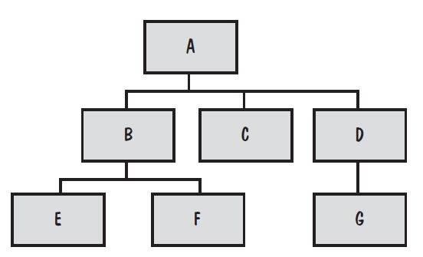
Integration Testing
System viewed as a hierarchy of components

Slide 29
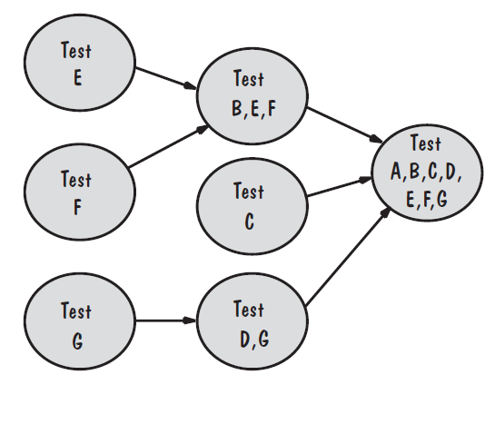
Integration Testing Bottom-Up Integration Example
Drivers are used to call the child functions
Drivers are relatively intelligent
Non-leaves drivers
Locating faults?

Slide 30
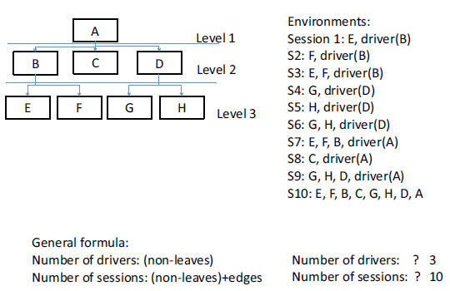
Integration Testing Bottom-Up Integration Example

Slide 31
Levels of Testing Testing Organization Illustrated

Slide 32
Unit Testing Code Review
Code walkthrough
In a walkthrough, you present your code and accompanying documentation to the review team, and the team comments on their correctness.
Code inspection
In an inspection, the review team checks the code and documentation against a prepared list of concerns. It is more formal.

Slide 33
Unit Testing
Testing the unit for correct functionality
Testing the unit for correct execution

Slide 34
Unit Testing Steps in Testing
Determining test objectives
Selecting test cases
Executing test cases

Slide 35
Unit Testing Whitebox Test Thoroughness
Statement testing: Every statement in the component is executed at least once in some test.
Branch testing: For every decision point in the code, each branch is chosen at least once in some test.
Path testing: Every distinct path through the code is executed at least once in some test.

Slide 36
Example
void Result (int x, int y)
{ int result = x + y;
if (result > 0)
print << “Positive”;
else if (result < 0)
print << “Negative”;
}

Slide 37
Integration Testing
Big-bang
Bottom-up
Top-down
Sandwich testing

Slide 38
Integration Testing Terminology
Component Driver: a routine that calls a particular component and passes a test case to it
Stub: a special-purpose program to simulate the activity of the missing component

Slide 39
Integration Testing
System viewed as a hierarchy of components

Slide 40
Integration Testing Bottom-Up Integration Example
Drivers are used to call the child functions
Drivers are relatively intelligent
Non-leaves drivers
Locating faults?

Slide 41
Integration Testing Bottom-Up Integration Example

